Slide 1
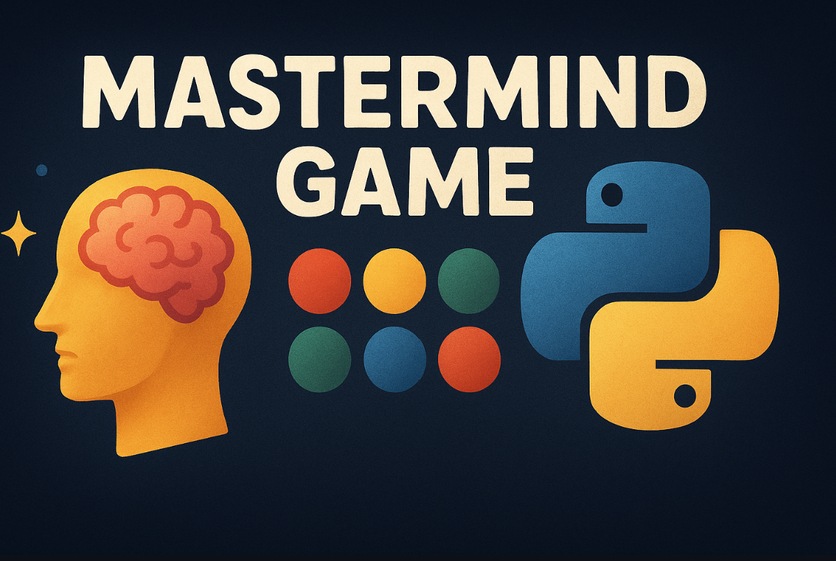
Mastermind Game
Software Engineering Project Team
Markus Maximus ( Scrum Master)
Laurenz Stelzl (Product Owner)
Mohammadali Vaezi – Developer and tester
Adnan Eminovic – Developer
Seyed Hossein Meymandi Nezhad – Developer
GitHub: https://github.com/alivaezii/mastermindgame
Wiki: https://github.com/alivaezii/mastermindgame/wiki
Notes:
Markus : Briefly introduce the team and responsibilities

Slide 2
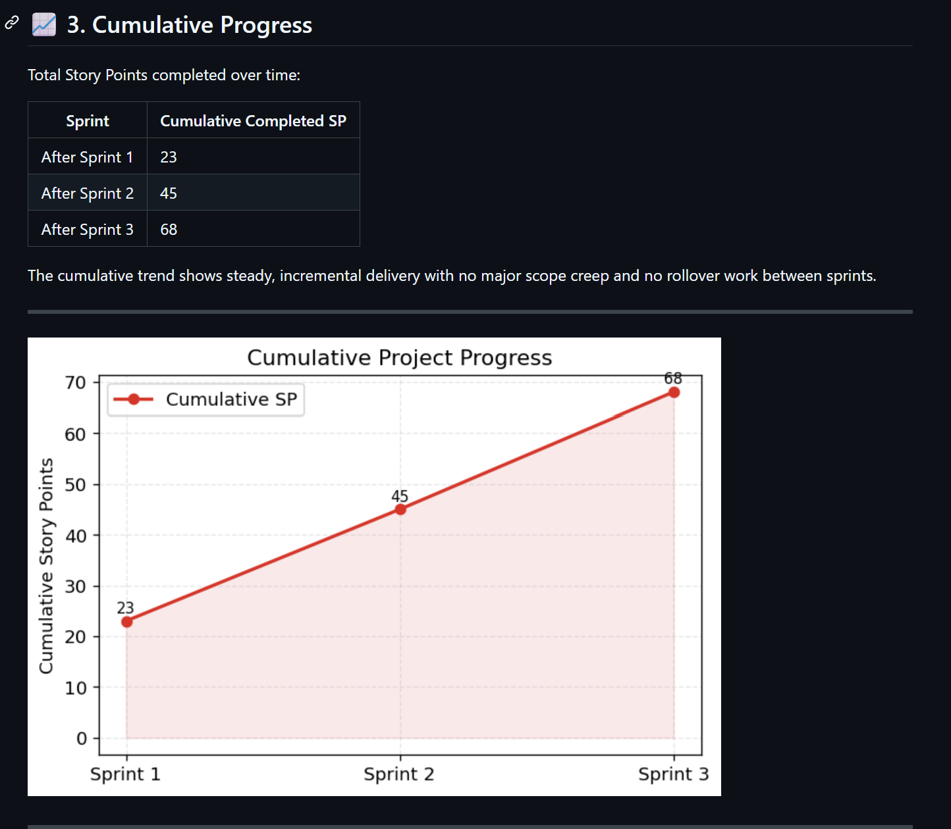
Project Overview & Product Backlog
The goal of this project is to design and implement a digital version of the Mastermind game that follows Agile principles.
The project includes a game engine, a CLI, a GUI prototype, automated tests, CI/CD, and complete documentation.
GitHub Wiki: Product Backlog: https://github.com/alivaezii/mastermindgame/wiki/Product-Backlog
Notes:
Laurenz: As Product Owner, my responsibility was to define what should be built and why, not how it is implemented.
At the beginning of the project, we created a Product Backlog that summarizes all functional and technical requirements of the Mastermind game.
The backlog is structured by Epics and prioritized using the MoSCoW method.
Each backlog item was estimated using Story Points, and the work was distributed across three sprints.
Sprint 1 focused on the core game logic and CLI, Sprint 2 on improving usability and quality, and Sprint 3 on GUI, Docker, and documentation.
The backlog allowed us to clearly separate must-have features, such as the game engine, input validation, tests, and CI, from optional features, like advanced GUI elements or animations.
During the project, we regularly reviewed the backlog and checked which items were completed.
This helped us to track progress, manage scope, and ensure that the project stayed aligned with the course goals.
From a product perspective, the core engine, CLI, Dockerization, and documentation are complete, and a GUI prototype has been delivered.
Based on the backlog status, the project is ready for submission. and you can see the details in our GitHub Wiki

Slide 3
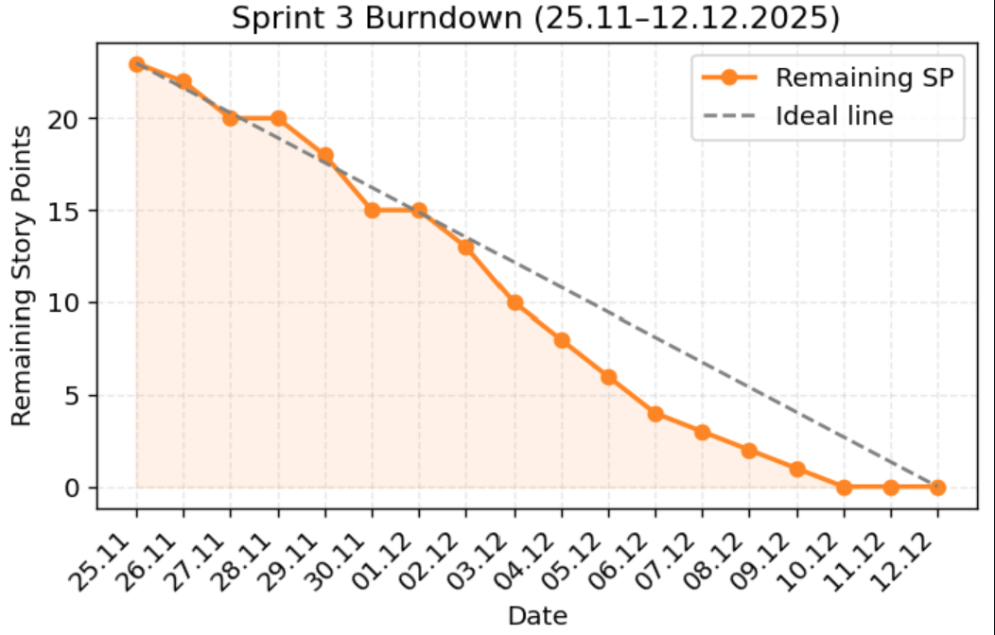
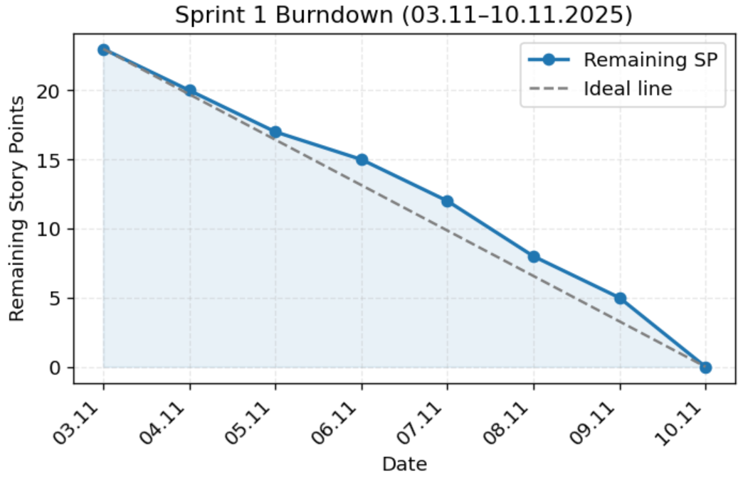
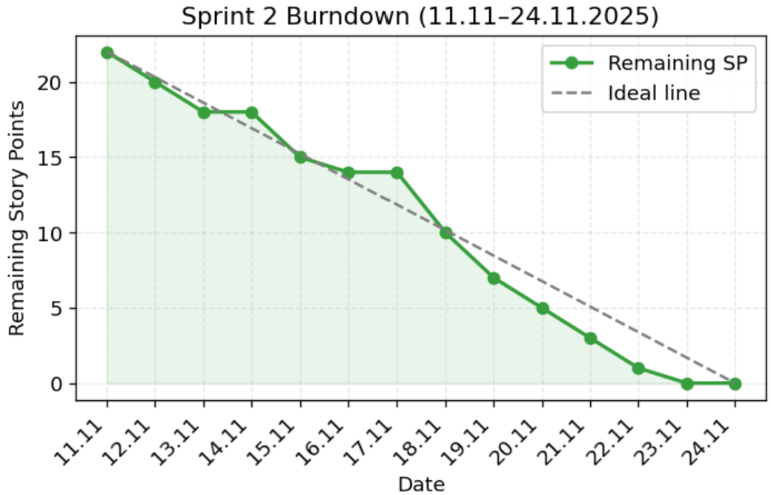
Scrum Process & Team Coordination
Scrum framework with three sprints
Sprint Planning, Review, Retrospective
Online ceremonies due to exam schedule
Technology decision: Java → Python
Story Points estimation using Planning Poker
Full documentation in Wiki (Sprints & Retros)
https://github.com/alivaezii/mastermindgame/wiki/Agile-Metrics
https://github.com/alivaezii/mastermindgame/wiki/Sprint-Backlogs
Notes:
Markus: As Scrum Master, my role was to support the Agile process, facilitate Scrum events, and help the team remove obstacles.
We worked in three sprints, each with a clear sprint goal defined during Sprint Planning.
The sprint backlog was selected from the product backlog based on priority and team capacity.
Due to our exam schedules, it was not always possible to meet in person.
Therefore, most Scrum ceremonies, such as Sprint Planning, Reviews, and Retrospectives, were held online, which allowed us to stay flexible while keeping regular communication.
During the early phase of the project, we faced technical difficulties with Java, especially regarding setup, tooling, and development speed.
After openly discussing this in the team and reviewing the risks in a retrospective, the team decided to switch to Python.
This decision improved development speed, testability, and CI integration, and was documented transparently in the Wiki and retrospectives.
For effort estimation, we used Planning Poker and assigned Story Points to user stories.
Story Points helped us estimate relative complexity, not time, and allowed better sprint planning.
After each sprint, we conducted a retrospective, documented what went well, what did not, and which improvements to apply in the next sprint.
All sprint results, decisions, and lessons learned were fully documented, ensuring transparency and traceability.
Overall, Scrum helped the team stay structured, adaptive, and focused, despite external constraints such as exams.

Slide 4
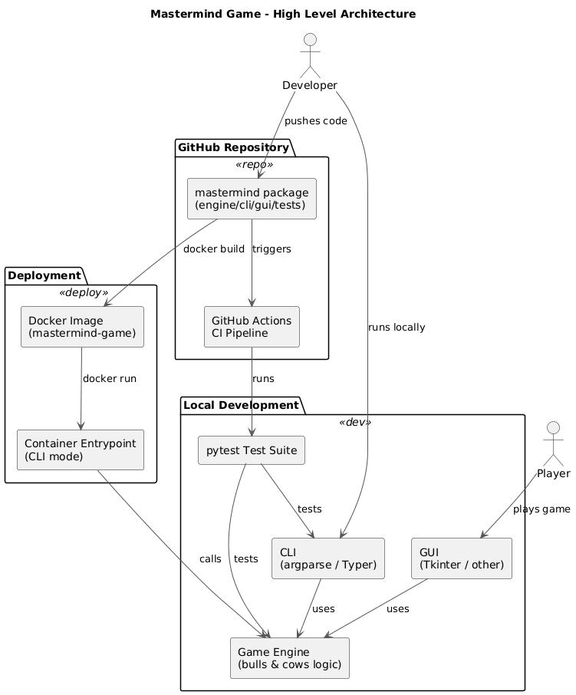
System Architecture & Design Decisions
Modular architecture with clear separation of concerns
Core game logic independent from UI and infrastructure
Designed for testability, extensibility, and maintainability
Main Architectural Modules
Game Engine (core logic)
CLI Interface
GUI Prototype Test Suite
CI/CD & Docker Infrastructure
Relation to Course Content
Layered architecture
Model–View separation
Use of basic design patterns
Notes:
Adnan: I will briefly explain the architecture of our Mastermind project and how it relates to the software engineering concepts we learned in this course.
We decided to use a modular architecture with a clear separation of concerns. The most critical design decision was to isolate the game engine from the user interfaces and infrastructure. This means that all core logic, such as validation and scoring, is implemented only once in the engine module.
Both the CLI and the GUI prototype use this engine. This approach follows the Model–View principle, which we discussed in class. The engine represents the model, while CLI and GUI act as different views.
This structure makes the project easier to test. Our test suite directly tests the engine without depending on the user interface. It also enables future extensions, such as adding another interface, without changing the core logic.
Overall, this architecture improves maintainability and readability and aligns well with the design principles taught in the course.

Slide 5
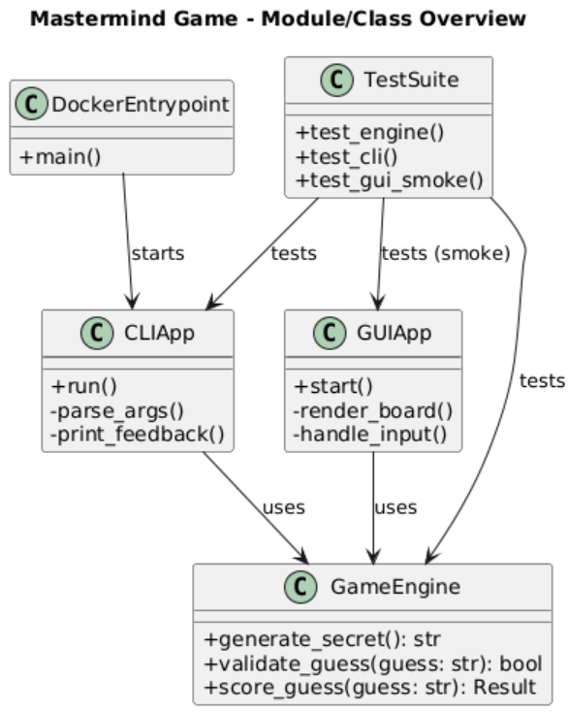
Design Patterns Used
Applied Design Patterns
Strategy-like behavior for rules configuration
Factory-style logic for secret generation
Single Responsibility Principle across modules
Why Patterns Were Useful
Reduced coupling between components
Easier refactoring and testing
Clear mapping to theoretical concepts from lectures
https://github.com/alivaezii/mastermindgame/wiki/Architecture-Overview
Notes:
Hossein: Regarding design patterns, we did not aim to over-engineer the project; we consciously applied them where they made sense.
For example, the rules configuration behaves similarly to a Strategy pattern, because different rule sets can be applied without changing the game flow.
The secret generation logic follows a Factory-style approach, where the engine decides how the secret is created based on the rules.
Additionally, we consistently followed the Single Responsibility Principle. Each module has a clear and focused responsibility, which simplifies refactoring and debugging.
These decisions helped us keep the code clean and aligned with our learnings on maintainable software design.

Slide 6
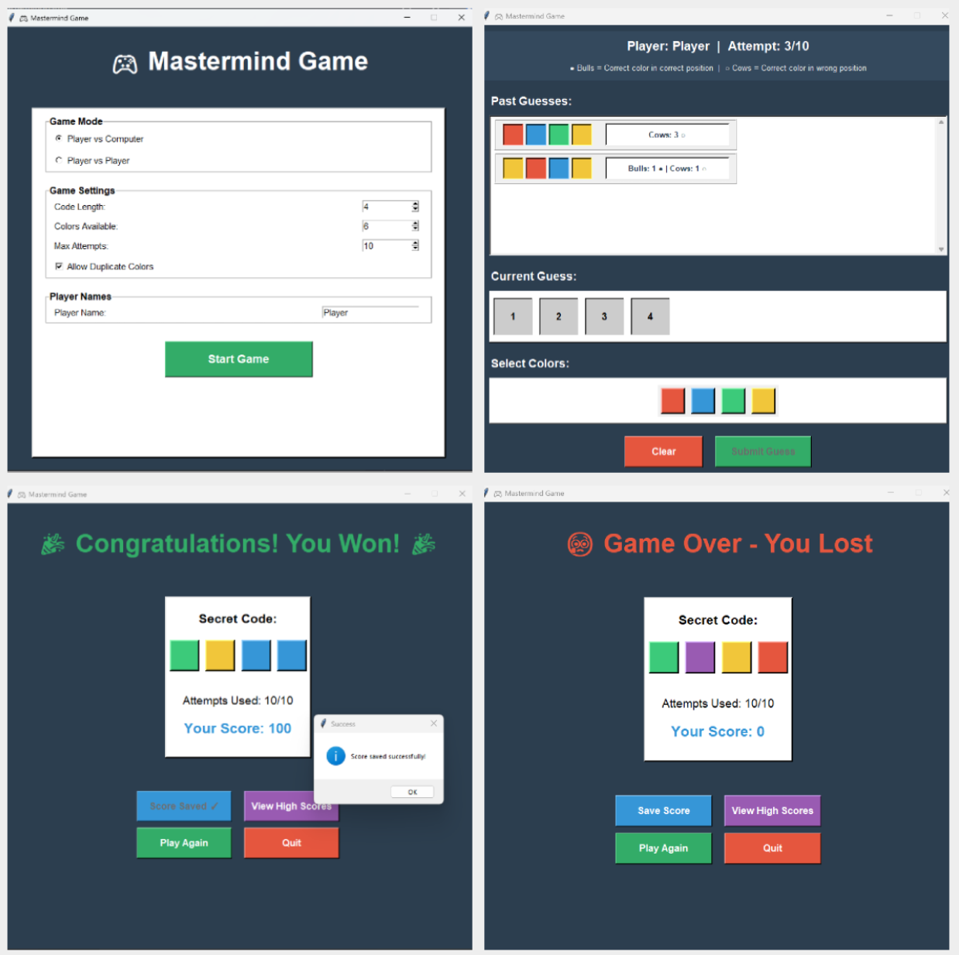
Refactoring & Architectural Evolution
Refactoring Decisions
Initial Java-based approach replaced by Python
Refactoring driven by complexity and maintainability
Continuous cleanup during Sprint 2
Reasons for Refactoring
Improve readability and structure
Reduce unnecessary complexity
Support faster development and testing
Notes:
Ali: During the project, we performed several refactoring steps, especially in Sprint 2.
Initially, we experimented with a Java-based solution, but we faced complexity issues and slower iteration speed. As a team, we decided to switch to Python, which allowed us to move faster and focus more on software quality rather than boilerplate code.
Refactoring was not done at the end, but continuously. We cleaned unused imports, simplified module structures, and improved naming and documentation.
These refactoring steps significantly improved code clarity and helped us reach a stable and well-structured final solution.

Slide 7
KPI Metrics
Area | Metric | Exact Value | Interpretation | Java / IntelliJ Equivalent
Version Control | Total commits | 92 | Continuous, incremental development | Git
CI Stability | CI jobs | 2 / 2 successful | Stable automated pipeline | Jenkins / GitHub Actions
Runtime | Python versions tested | 3.10, 3.11 | Cross-version compatibility | Multi-JDK CI
Testing | Tests passed | 68 / 68 (100%) | All tests green | JUnit 5
Testing | Test execution time | ≈ 0.35 s | Fast feedback loop | Surefire
Coverage | Line coverage (core+CLI) | 95% | High test effectiveness | JaCoCo
Static Quality | Lint issues | 0 | Clean, consistent code | Checkstyle / IDE inspections
Static Quality | Type errors | 0 | Strong type safety enforced | Java compiler checks
Documentation | Doc coverage | 92.6% | Well-documented code | JavaDoc rules
Complexity | Worst cyclomatic complexity | C (16) | One refactoring candidate | SonarQube
Code Size | Core source LOC | 2054 | Main application logic | LOC (IntelliJ Stats)
Code Size | Test LOC | 878 | Dedicated test suite | Test sources
Code Size | Total LOC | 2932 | Medium-sized student project | —
Quality Ratio | Test / Core ratio | 0.43 : 1 | Balanced testing effort | Test/Core ratio
The metrics show good quality: high coverage, clean code, no type or lint errors, and controlled complexity.
Notes:
Ali: This slide is significant for our project because it shows measurable evidence of quality, not just functionality.
After defining the architecture and the Agile process, we evaluated the project using objective KPIs. These metrics help us verify whether our technical and organizational decisions were effective.
From a process perspective, the project shows continuous development with 92 commits and a stable CI pipeline, where all jobs pass on multiple Python versions. This confirms that our workflow is reliable and reproducible.
From a testing perspective, all 68 tests pass, with a total execution time of around 0.35 seconds, providing fast feedback during development. The 95%-line coverage for core and CLI modules indicates strong test effectiveness.
In terms of static quality, there are no lint issues or type errors, indicating consistent coding standards and enforced type safety.
Documentation quality is also high, with 92.6% docstring coverage, meaning the code is understandable and maintainable for future developers.
Regarding complexity, we measured cyclomatic complexity using Radon.
All modules except one are in grade A or B, indicating low and acceptable complexity according to the standard thresholds.
Only one function has a C rating with a value of 16, which we deliberately kept visible rather than hiding.
This function was identified as a refactoring candidate, not as a design flaw.
For the scope of this student project, this level of complexity is acceptable and well-controlled.
The critical point is that complexity is measured, documented, and transparent, and the overall architecture remains modular and maintainable.
Finally, the test-to-core code ratio of 0.43 indicates a balanced testing effort, appropriate for a student project of this size.
Overall, these KPIs confirm that the project meets academic software engineering standards and is ready for submission.

Slide 8
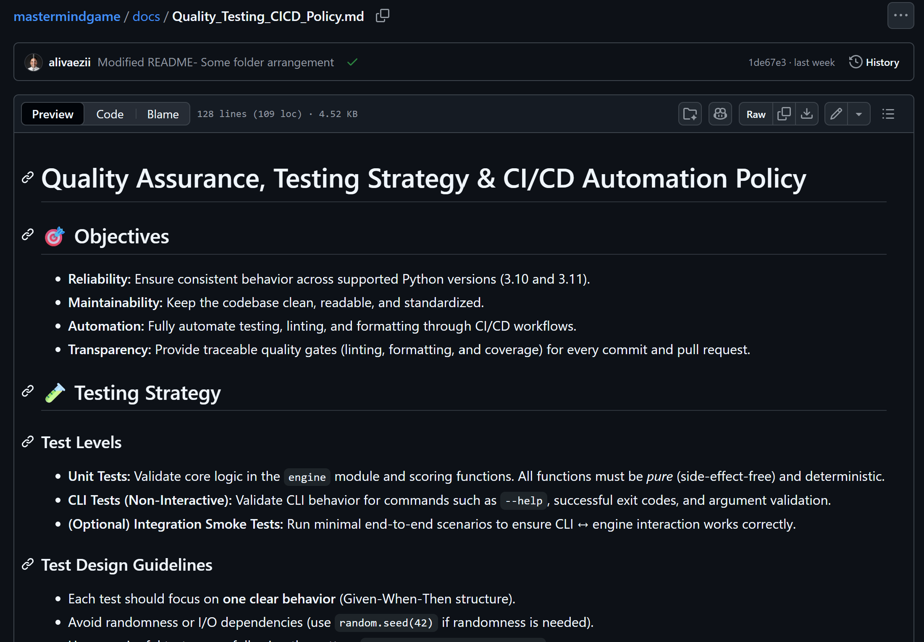
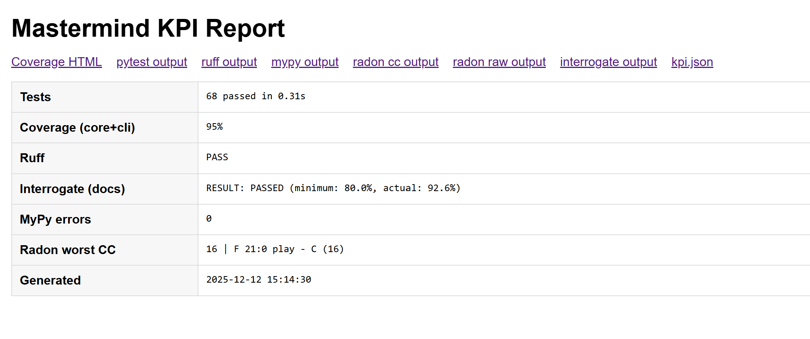
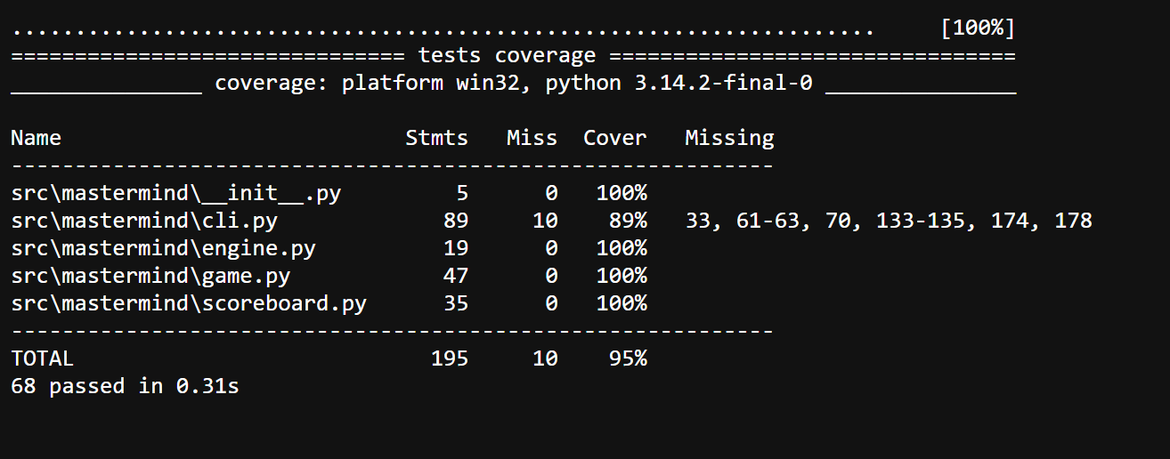
Notes:
Ali

Slide 9
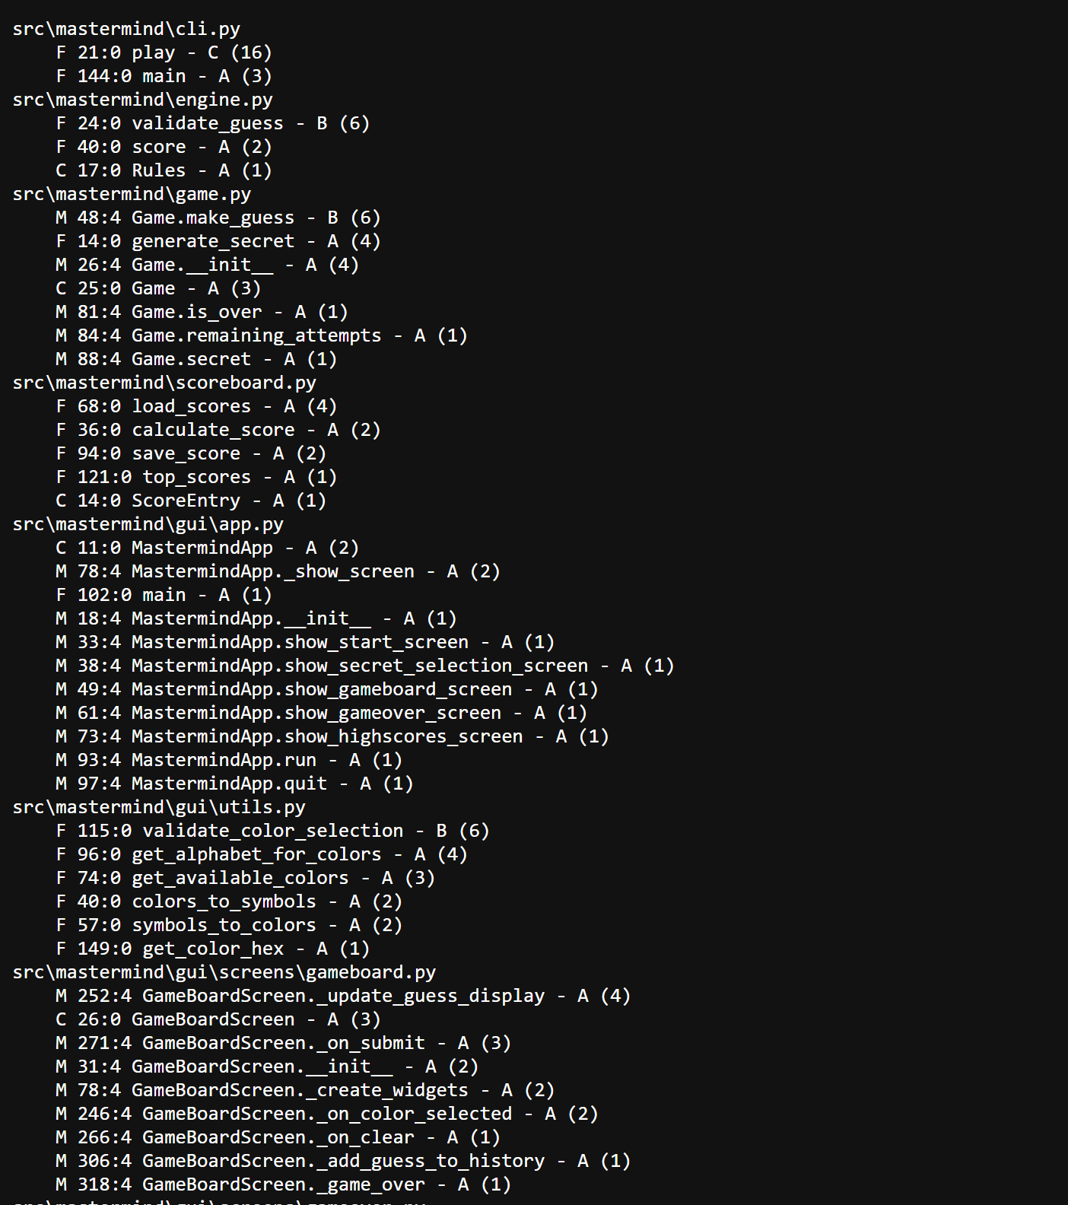
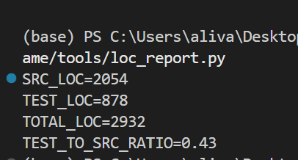
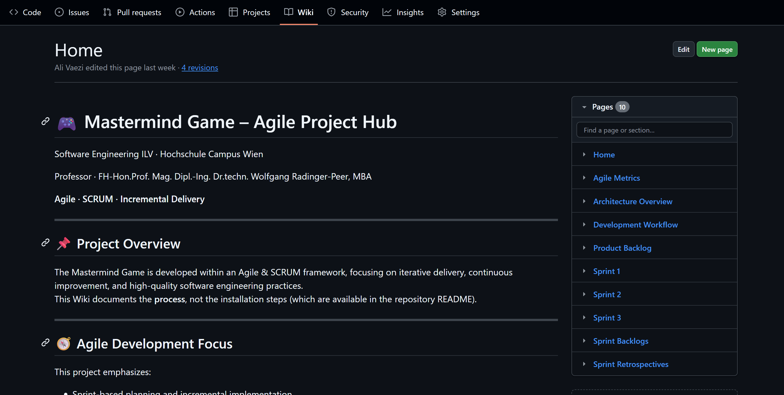
Notes:
Ali

Slide 10
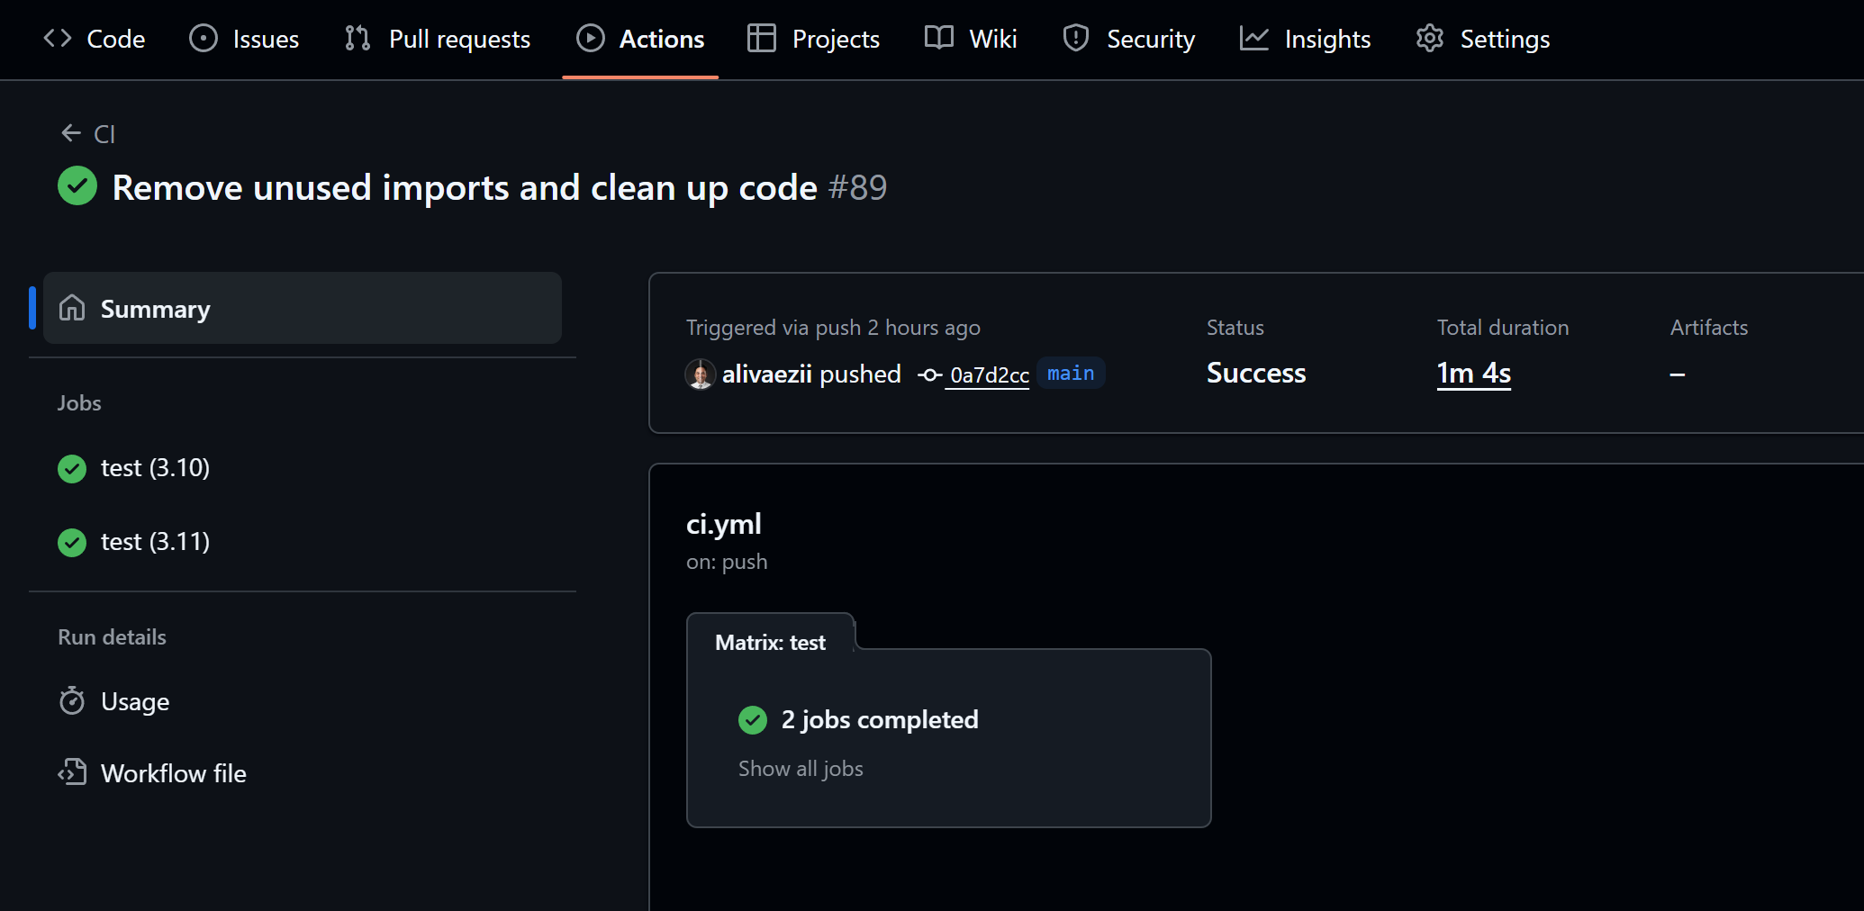
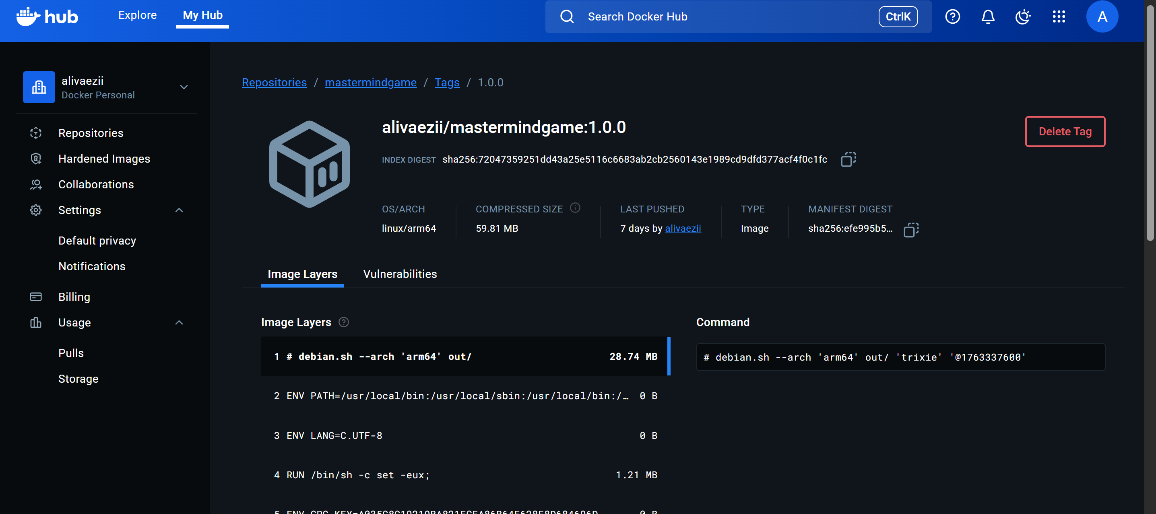
CI/CD & Docker: Automated Quality & Delivery
CI/CD (GitHub Actions)
Automated checks on every Pull Request
Linting, formatting, and tests executed automatically
Only green builds can be merged into main
Docker
Reproducible CLI runtime
No local setup required
Same behavior on all machines
Notes:
Ali : To wrap up the technical part of the project, I would like to explain our CI/CD and Docker setup briefly.
After a pull request was submitted, all quality checks were executed automatically using GitHub Actions.
This includes linting, code formatting, and automated tests.
Only when all checks passed successfully could the pull request be merged into the main branch.
This ensured that code quality was consistently enforced, and manual errors were reduced.
In addition, we provided a Docker setup for the project's CLI version.
Docker allows the game to run in a reproducible environment, independent of the local machine or operating system.
Together, CI/CD and Docker ensure that the project is easy to verify, easy to run, and ready for submission.

